Slide 1
PROBABILITY DISTRIBUTION
CO3: Apply discrete and continuous probability distributions in
analyzing the probability models arising in engineering field .
♦ Discrete Distribution
♦ Continuous Distribution
Apoorva m
1dt19cs022
team 5

Slide 2
Probability Distribution :
It is the systematic representation of the
values taken by a random variable with respective probabilities is called the
probability distribution.
Σp(x)= P1+P2+_ _ _ _ _ _ _ +Pn =1
X | X1 | X2 | _ _ _ _ _ _ | Xn
p(x) | p(x1) | P(x2) | _ _ _ _ _ _ | p(xn)

Slide 3
Continuous Distribution :
When the variable being measured is expressed on a continuous scale , its probability distribution is called a
continuous distribution.
Example : The probability distribution of
metal layer thickness is
continuous.

Slide 4
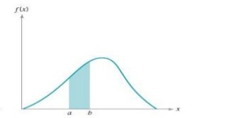
Continuous case

Slide 5
Discrete Distribution :
When the parameter being measured
can only take on certain values , such as the integers 0,1. the probability distribution is called a discrete distribution
Example : distribution of the number of nonconformities or defects in printed circuit boards would be a discrete distribution

Slide 6
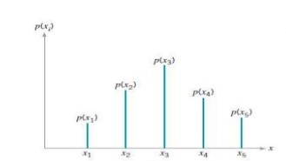
Discrete case

Slide 7
Binomial Distribution :
If p is the probability of success
And q is the probability of failure then the probability of x success out
of n trials is given by,
P(x) = ⁿcx p q
x
n-x
P =binomial probability
Mean = n*p
Variance=n*p*q

Slide 8
Poisson Distribution :
It is regarded as the limiting form of the binomial distribution when n is very large (n→∞) and p the probability of success is very small (p→0)
p(x)= e m
x!
-m
x
Mean = Variance = m
Standard deviation = σ = √m

Slide 9
Exponential Distribution :
The continuous probability distribution having the probability density function given by,
f(x)={
-αx
αe for x>0
0 otherwise
Where α>0 is known as the exponential distribution .
Mean = μ=(1/α)
Standard deviation =σ= (1/α)

Slide 10
Normal Distribution :
The contionuous probability distribution having the probability density function f(x) given by,
f(x)=(1/ σ√2π) ( )
where -∞<x<∞ and σ>0 is known as normal distribution .
-(x-μ)
2σ
2
e
2

Slide 11
Applications of probability distributions in real life :
● Binomial distribution : can be found in real life in case of if a new
drug is introduced to cure a disease ,it either cures the disease
(successful) or it doesn’t cure the disease (failure).
● Poison distribution : can be found in real life is can be seen in call
centers to model the number of expected calls per hour that they will
receive so they know how many call center reps to keep on staff.
●Exponential distribution: can be found in real life example is the time
until a radioactive particle decays or the time between one telephone
call and another telephone call.

Slide 12
●Normal Distribution : it can be found in real life in case of
measurements of heights , blood pressure, IQ scores .
It is also known as Gaussian distribution .
THANK YOU

Slide 13
CONFORMAL TRANSFORMATION
By: 1DT19CS023, Aryan

Slide 14
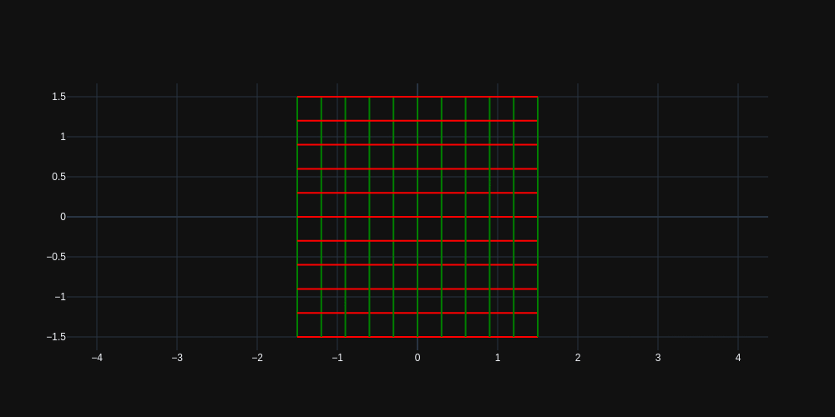
Conformal Mapping ?
A conformal map is a function which preserves the angles.
More formally, a map $w=f(z)$ is called conformal (or angle-preserving) at $z_{0}$ if it preserves oriented angles between curves through $z_{0}$, as well as their orientation, i.e. direction.
$$w=e^{z}$$

Slide 15

Conformal mapping-based 3D face recognition
Face is potentially the best biometrics for people identification related applications for its non instructiveness, contactless and socially well acceptance.
The proposed approach makes use of conformal UV parameterization for mapping purpose and Shape Index decomposition for similarity measurement.

Slide 16
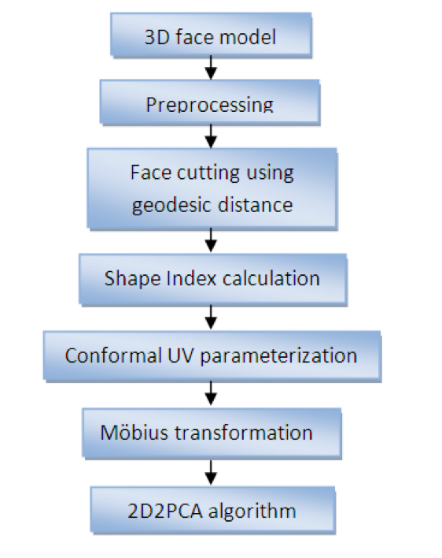
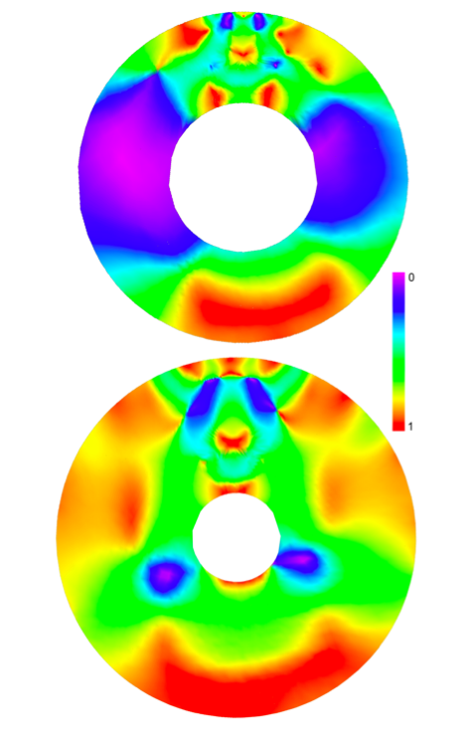
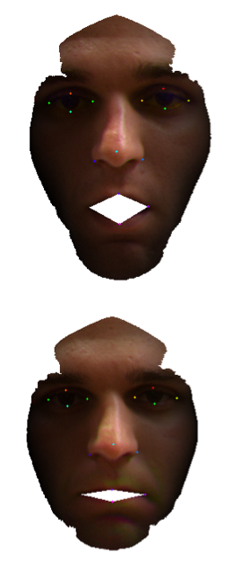
Flowchart
Conformal Map created from parametrized UV coordinates, colors represent Shape Index value. The mouth part has been mapped to the inner hole while outer face boundary to the boundary of circle.
Geodesic face cutting result with zero distance
between lips in presence
of expression.
Rasterized images are used as an input for $(2D)^{2}PCA$ recognition algorithm.

Slide 17
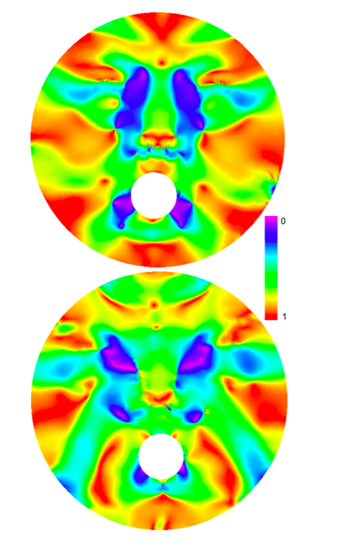


What about Facial Expressions ??
Möbius Transformation carried on UV conformal coordinates.
Following formula is used : $f(θ,z_{0},z)=e^{iθ}\frac{(z-z_{0})}{1-{\overset{˜}{z}}_{0}z}$,
where $z=(u+iv)$ complex number within unit disk.
$θ,z_{0}$ and $z$ are parameters.
Conformal maps transformed by Möbius
Transformation with centre point in the nose tip
🤔😂🥲😘😜😋☹️😡😐🙄

Slide 18
Thank You

Slide 19
Maths Creative assessment Name:Azeem Husain Khan USN:1DT19CS024
Module : Joint probability distributions

Slide 20
Joint Probability Distribution:
In general, if X and Y are two random variables, the probability distribution that defines their simultaneous behavior is called a joint probability distribution.
For example: X : the length of one dimension of an injection- molded part, and Y : the length of another dimension.
We might be interested in P(2.95 < X < 3.05 and 7.60 <Y <7.80)

Slide 21
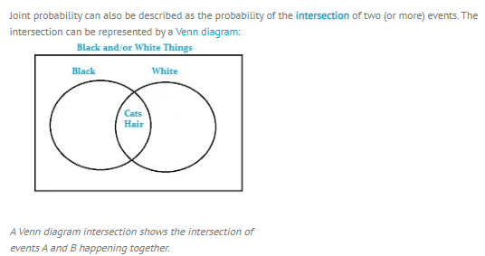
Joint Probability Distribution:

Slide 22
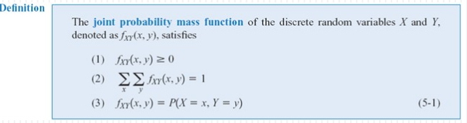
Joint Probability Distribution:
The joint probability distribution of two random variables =bivariate probability distribution.
The joint probability distribution of two discrete random variables is usually written as P(X=x, Y=y).

Slide 23

Application of Joint probability Distribution Examples of Real Life Joint probability distribution : 1. Analysts: Use joint probability as a tool when two or more observable events can occur simultaneously . 2. Sports Strategies : ex : A cricket coach evaluates a player's batting and bowling capability by taking his average performances in previous matches before placing him in the lineup.

Slide 24
Thank you

Slide 25
APPLICATION OF CORRELATION AND REGRESSION
PRESENTED BY: BANU PRIYA B NAIK
1DT19CS025

Slide 26
CORRELATION AND REGRESSION
Correlation analysis is a form of statistics that helps to determine the relationship between two variables where a high correlation indicates a strong relationship, and a weak correlation indicates that they are not closely related.

Slide 27
APPLICATION OF CORRELATION AND REGRESSION:
Basic examples of correlation can be seen around us in our daily lives when we say that the demand and price of a commodity are correlated, or the amount of rainfall and crop output of an area are correlated.
An important aspect is that when the price of the commodity goes up, and its demand goes down; they are negatively correlated.
On the other hand, when the rainfall received in a region is high, and its crop production increases; they are said to be positively correlated.
In general, the value of r lies in a range between -1 to 1; and we can say that if the value of r is such that:
1>r>0, positive correlation exists
r=0, no correlation exists-1<r<0
negative correlation exists

Slide 28
APPLICATION OF LINEAR REGRESSION IN BUSINESS
Businesses often use linear regression to understand the relationship between advertising spending and revenue.
For example, they might fit a simple linear regression model using advertising spending as the predictor variable and revenue as the response variable. The regression model would take the following form:
revenue = β0 + β1(ad spending)
The coefficient β0 would represent total expected revenue when ad spending is zero.

Slide 29
The coefficient β1 would represent the average change in total revenue when ad spending is increased by one unit (e.g. one dollar).
If β1 is negative, it would mean that more ad spending is associated with less revenue.
If β1 is close to zero, it would mean that ad spending has little effect on revenue.
if β1 is positive, it would mean more ad spending is associated with more revenue.
Depending on the value of β1, a company may decide to either decrease or increase their ad spending.

Slide 30
APPLICATION OF LINEAR REGRESSION IN MEDICAL RESEARCHES:
Medical researchers often use linear regression to understand the relationship between drug dosage and blood pressure of patients.
For example, researchers might administer various dosages of a certain drug to patients and observe how their blood pressure responds. They might fit a simple linear regression model using dosage as the predictor variable and blood pressure as the response variable. The regression model would take the following form:

Slide 31
blood pressure = β0 + β1(dosage)
The coefficient β0 would represent the expected blood pressure when dosage is zero.
The coefficient β1 would represent the average change in blood pressure when dosage is increased by one unit.
If β1 is negative, it would mean that an increase in dosage is associated with a decrease in blood pressure.
If β1 is close to zero, it would mean that an increase in dosage is associated with no change in blood pressure.
If β1 is positive, it would mean that an increase in dosage is associated with an increase in blood pressure.
Depending on the value of β1, researchers may decide to change the dosage given to a patient.

Slide 32
CONCLUSION:
Linear regression is used in a wide variety of real-life situations across many different types of industries. Fortunately, statistical software makes it easy to perform linear regression.

Slide 33


